Slide 1



Predicting
Stars, Galaxies and Quasars
Team 8: Aditi Nankar, Lily Saltonstall, Ian O’Connor, Shiki Pawan

Slide 2
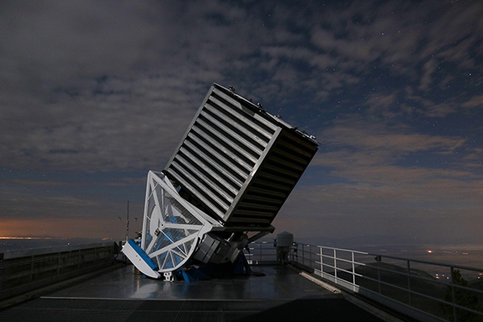


Sloan Digital Sky Survey
The Sloan Digital Sky Survey is a facility that maps, tracks, and photographs the cosmos. They are pioneers of panoptic spectroscopy, collecting data gathered from their many ongoing cosmic surveys. They dataset we used for our project was found on Kaggle.com and features over 10,000 rows of data from nearby and distant stars, galaxies, and quasars!
The Sloan Digital Sky Survey Telescope
Image Credit: Patrick Gaulme, Data Release 17 | SDSS

Slide 3

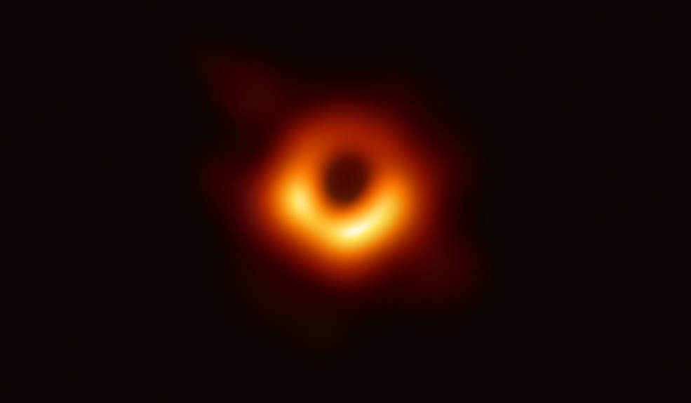
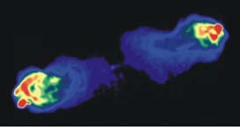
Stars
Fueled by radiation, they emit light across the electromagnetic spectrum. Stars with light in the ultraviolet or blue wavelengths are hotter and stars with red wavelengths are cooler.
Galaxies
Quasars
Galaxies are massive celestial bodies containing multitudes of stars and solar systems within them.
Many large galaxies
have a
supermassive
black hole
at their center.
The most luminous objects in the cosmos, giving off light across the entire spectrum. These beams of raw energy are emitted by supermassive black holes at the core of galaxies. Particles are trapped by the powerful magnetic field and are violently ejected from the magnetic poles.
Fun Fact!
Gas and dust whip around the black hole in a swirling vortex of terror known as an accretion disk. The gas is heated up to temperatures that are millions of degrees and cause the quasar to emit thermal radiation that is so bright it can be seen across the light spectrum.
The quasar located nearest to Earth is called Markarian 231 and is located in the constellation Ursa Major (the big dipper).
Cygnus a is one of the first quasars ever discovered! Pictured here
Image Credit: https://voyages.sdss.org/expeditions/universe/quasars/early-radio-astronomy/

Slide 4
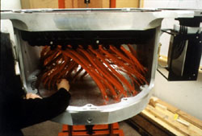


The Data Used
(and what it means)
SDSS photometric system:
These are optical filters used in a telescope known as passbands. The filters ensure high efficiency for faint object detection and essentially cover the entire accessible optical wavelength range.
u = Ultraviolet/Blue Wavelengths
g = Green Wavelengths
r = Red Wavelengths
i = Near Infrared
z = Infrared
The SDSS’s Spectrograph (seen from the side)
Image Credit: https://skyserver.sdss.org/dr1/en/proj/basic/color/fromstars.asp

Slide 5

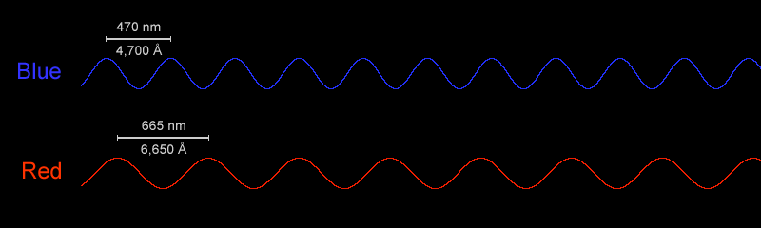
The Data Used
(continued)
Coordinate System
Redshift
ra = Right Ascension (longitude)
dec = Declination (latitude)
The stretching of wavelength and the shifting of light towards the red end of the light spectrum as celestial objects move away from Earth.
Redshifting can be compared to the Doppler Effect which is the same concept but with sound and on a smaller scale.
Declination
Right Ascension
Image Source: https://scied.ucar.edu/image/wavelength-blue-and-red-light-image

Slide 6


Import and Load Data

Slide 7

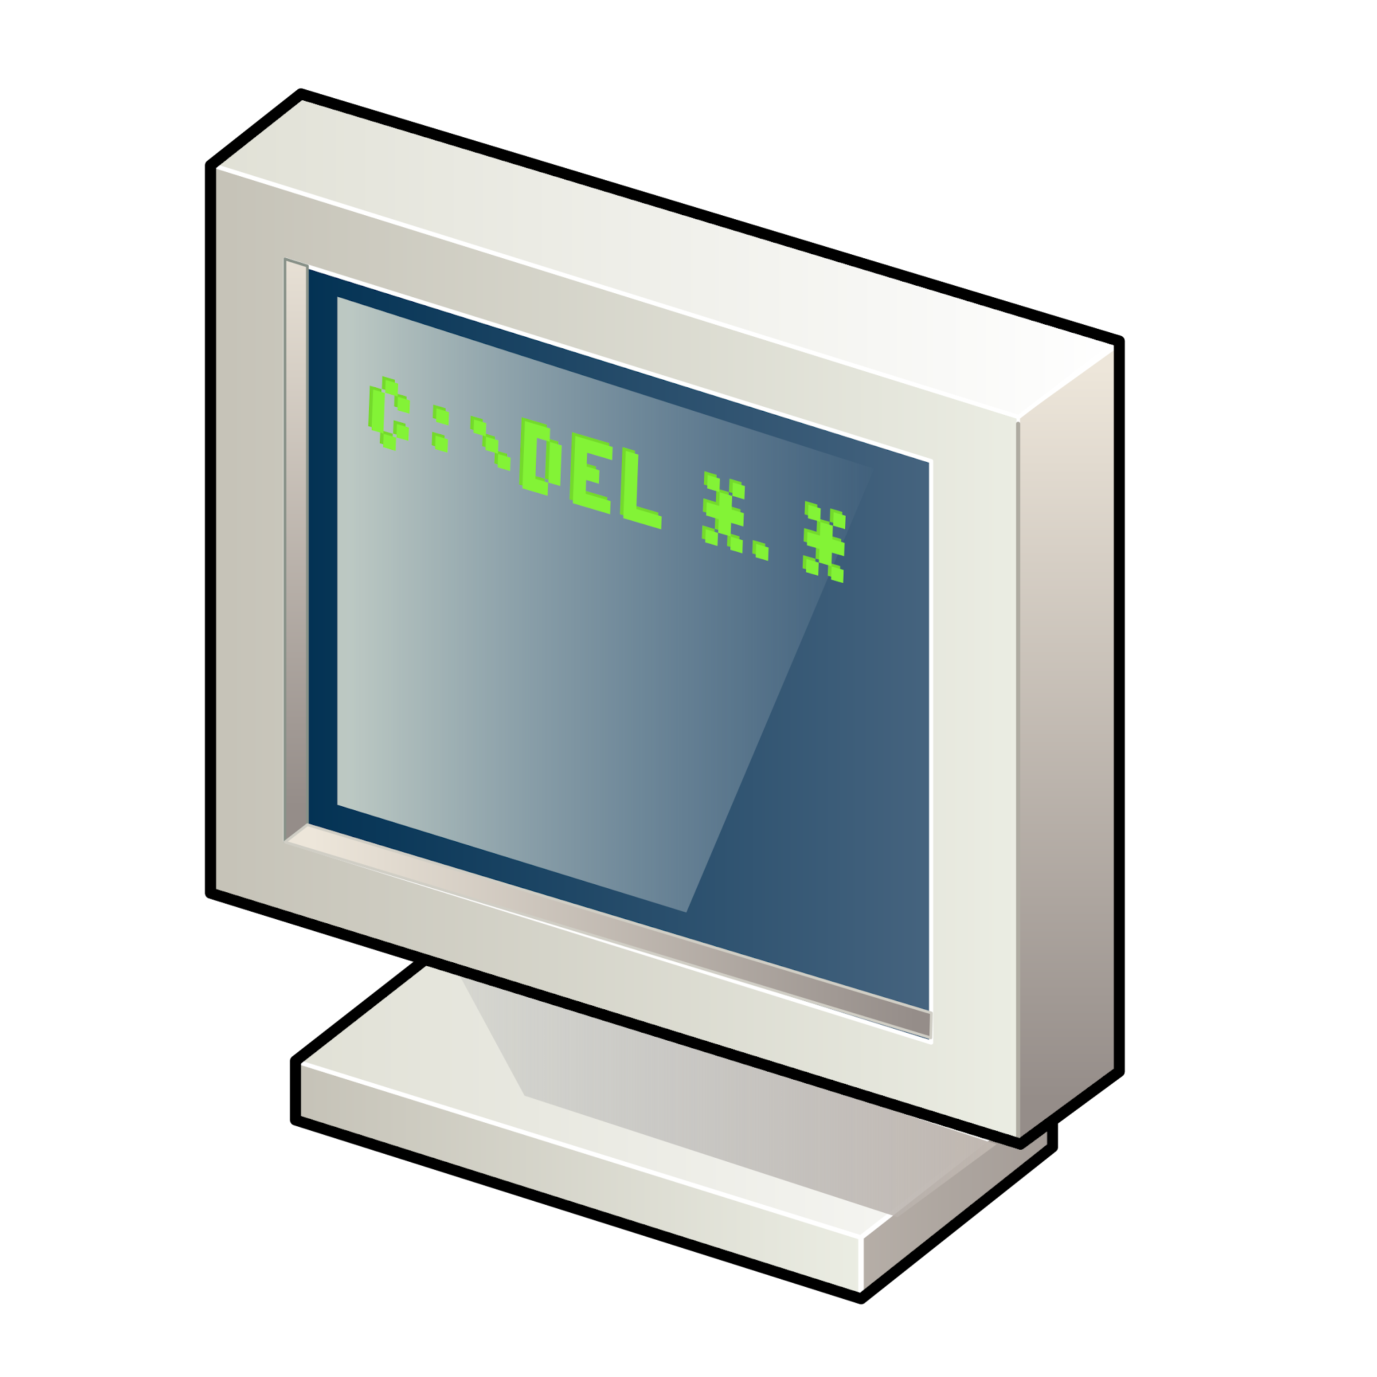


Imported Libraries
matplotlib
seaborn
pandas
numpy
plotly
sqlalchemy
sklearn
tqdm

Slide 8
SQL Database Integration
1. Create
2. Populate
Created our ‘StarsGalaxiesQuasars’ database and schema code
Imported our Sloan Sky Survey CSV data from Kaggle via Postgres
3. Connect
4. Load
Established a database connection in our JupyterLab Notebook using SQL Alchemy
Loaded the results of our SELECT queries into a Pandas dataframe for analysis

Slide 9

Exploratory Data Analysis

Slide 10
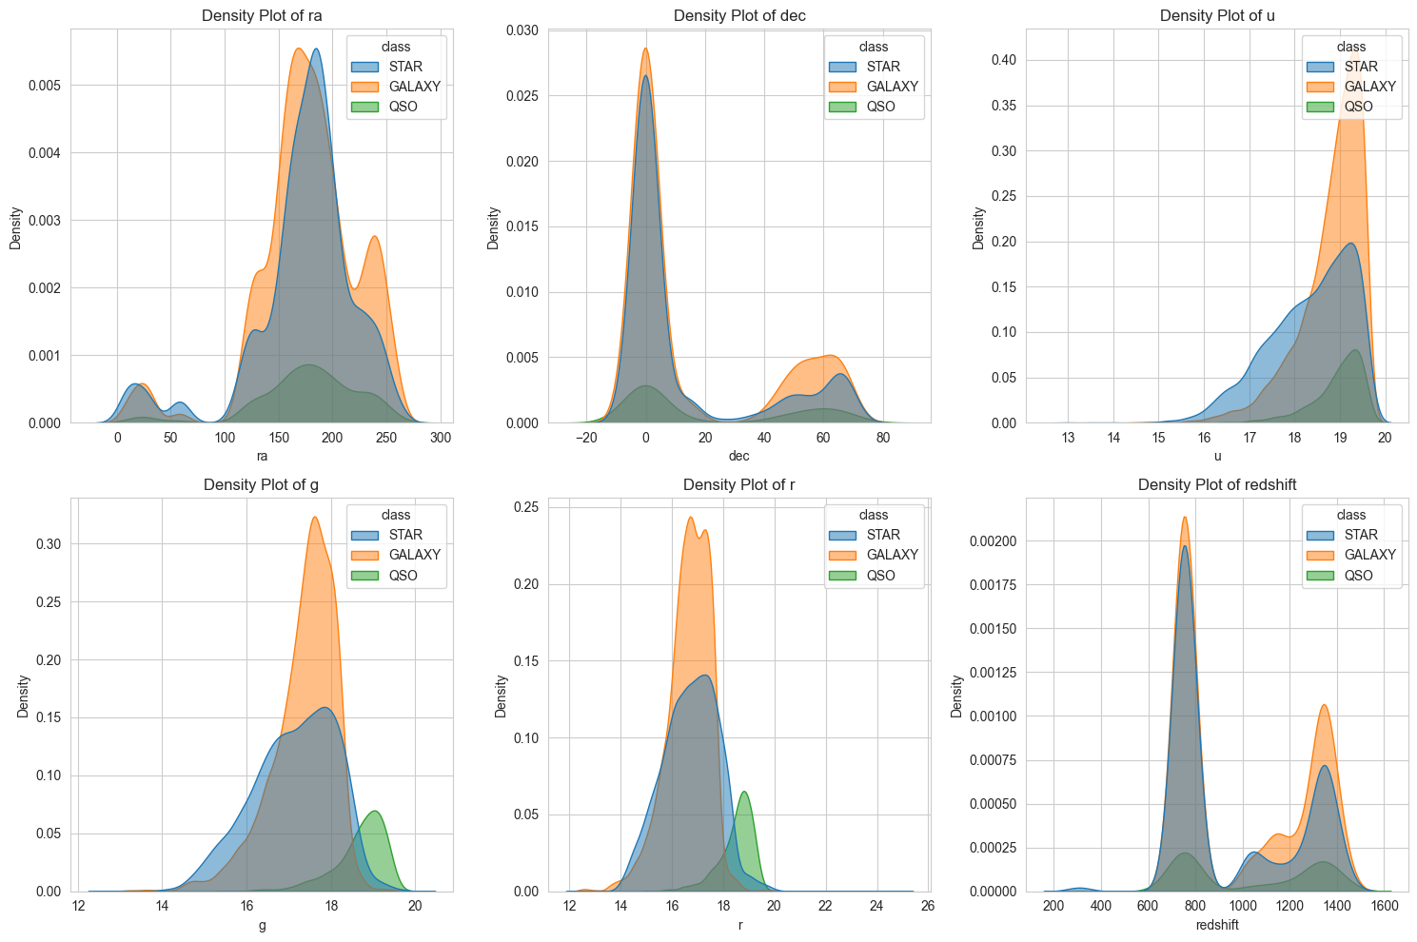
Density Plot Visual

Slide 11



Findings
Fun fact
There’s a giant space blob of alcohol on a distant cloud of gas called, Sagittarius B2. There’s enough alcohol to make 400 trillion pints of beer
Takeaway
Because of its direct correlation with our target variables, we decided to remove the redshift column from our features to help mitigate data leakage
Correlation
Redshift is the most distinguishing feature – stars have low redshift, galaxies have medium redshift, and quasars have high redshift

Slide 12
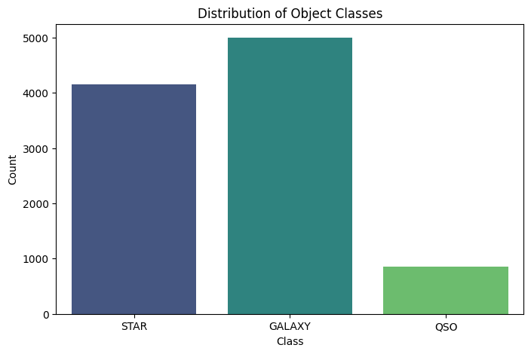
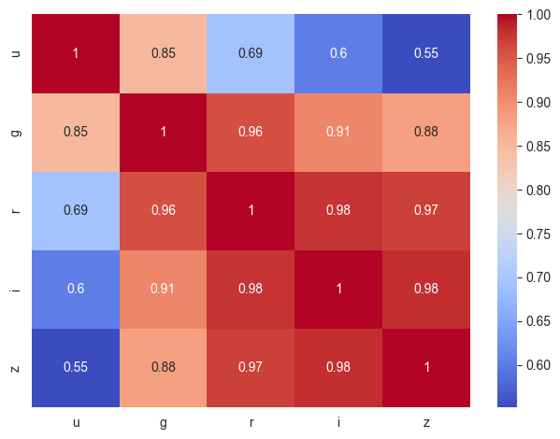
Exploratory Data Analysis
Visuals

Slide 13




Findings
Correlation
Takeaway
Even without the redshift, our correlation heatmap still shows heavy correlation among our key data features
Data imbalance and heavy feature correlation may cause issues with our training and analysis
Imbalance
Our count plot shows us that there are significantly more stars and galaxies in our target (Y) data compared to quasars
Fun Fact
Footprints left on the Moon won’t disappear as there is no wind

Slide 14

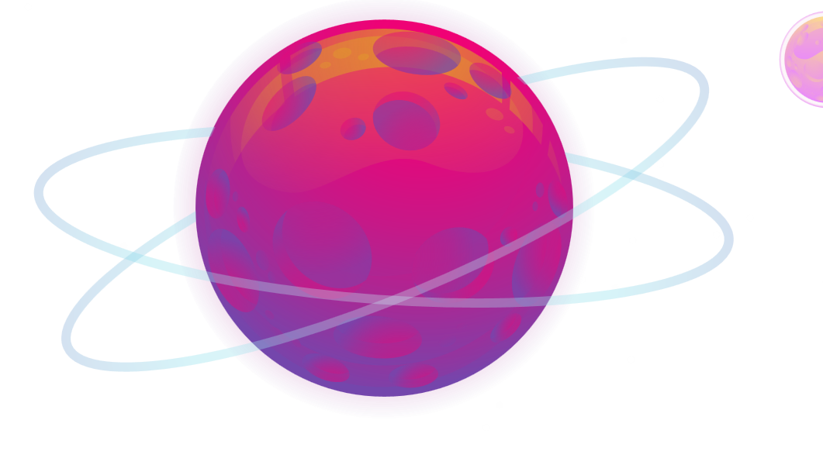
Data Pre-Processing

Slide 15
Filtering Our Dataset
Unused Columns:
objid = Object Identifier
specobjid = Object Identifier
run = Run Number
rerun = Rerun Number
camcol = Camera Column
plate = Plate Number
field = Field Number
fiberid = Fiber ID
ra = Right Ascension
dec = Declination
mjd = Modified Julian Date
redshift = Object’s Redshift Value
Used Columns:
class = Class (galaxy, star, quasar)
u = Ultraviolet/Blue Wavelengths
g = Green Wavelengths
r = Red Wavelengths
i = Near Infrared
z = Infrared

Slide 16
Key Features Used
U
G
R
Ultraviolet/blue
Green
Red
I
Z
Near infrared
Infrared

Slide 17

Other Data Preprocessing Steps
Encoding
Splitting
Scaling
Encoding target variable
(STAR → 0, GALAXY → 1, QSO → 2)
Splitting dataset into training (80%) and testing (20%) sets
Normalizing values using StandardScaler

Slide 18

Machine Learning Models

Slide 19

SVM
(Support Vector)
Random Forest
Results:
precision recall f1-score support
star 0.92 0.97 0.94 832
galaxy 0.95 0.94 0.95 999
qso 0.96 0.79 0.86 169
accuracy 0.94 2000
macro avg 0.94 0.90 0.92 2000
weighted avg 0.94 0.94 0.94 2000
Logistic Regression
Results:
precision recall f1-score support
star 0.92 0.95 0.94 832
galaxy 0.96 0.93 0.94 999
qso 0.89 0.89 0.89 169
accuracy 0.94 2000
macro avg 0.92 0.93 0.92 2000
weighted avg 0.94 0.94 0.94 2000
Results:
precision recall f1-score support
star 0.91 0.96 0.93 832
galaxy 0.96 0.92 0.94 999
qso 0.93 0.90 0.92 169
accuracy 0.94 2000
macro avg 0.93 0.93 0.93 2000
weighted avg 0.94 0.94 0.94 2000
Gradient Boosting
Results:
precision recall f1-score support
star 0.84 0.90 0.87 832
galaxy 0.92 0.87 0.89 999
qso 0.90 0.85 0.87 169
accuracy 0.88 2000
macro avg 0.89 0.87 0.88 2000
weighted avg 0.88 0.88 0.88 2000

Slide 20

Check for Data Leakage
Step 1
Step 2
Examine and thoroughly research all data features used and determine their impact and/or significance
Gradually modify select data features and test repetitively for any changes in accuracy

Slide 21
Gradient Boosting Model
Gradient boosting is a prediction model similar to Random Forest commonly used in sales forecasting, stock price prediction, fraud detection, and financial modeling, Gradient boosting models are commonly used to win Kaggle competitions due to their accuracy.
Boosting improves model performance by correcting the mistakes of previous learners with new ones. It uses weak learners, like decision stumps, which perform slightly better than random guessing. These weak learners are sequentially added, focusing on correcting errors at each step.
A key difference between the gradient boosting model and the random forest model is overfitting. While adding more trees in random forests doesn’t cause overfitting, in gradient boosting, too many weak learners can lead to overfitting the data. This makes careful hyperparameter tuning even more essential when using gradient boosting models.

Slide 22
Steps for GB Model Optimization
Tuning
Visuals
PCA
Establish optimum hyperparameters and train on them
Observe feature importance and confusion matrix visual aids
Improve efficiency and performance with data compression

Slide 23

GB Hyperparameter Tuning
Used RandomizedSearchCV to search for best hyperparameters.
Best Parameters Found:
n_estimators=300
learning_rate=0.2
max_depth=7
min_samples_leaf=2
subsample=0.9

Slide 24
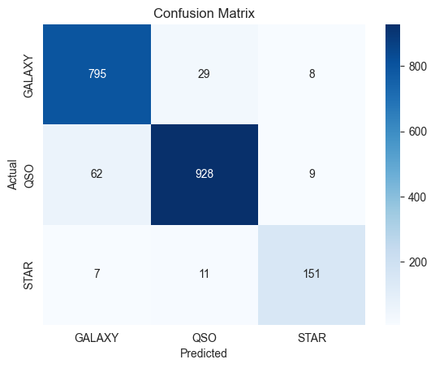
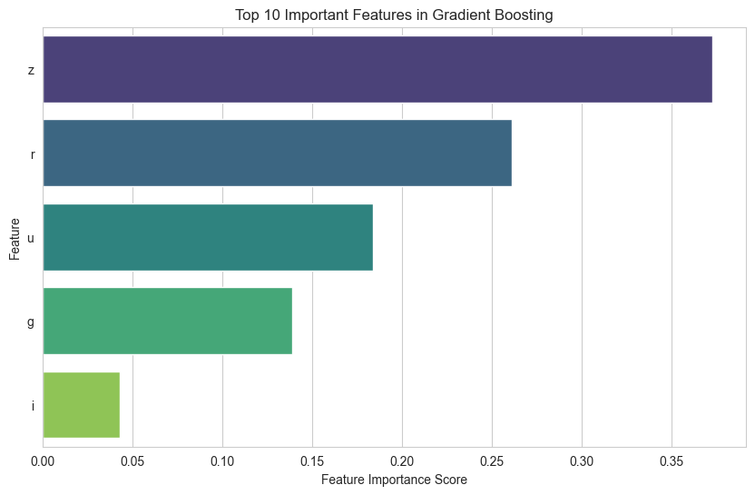
Tuned GB Parameter Visuals:

Slide 25


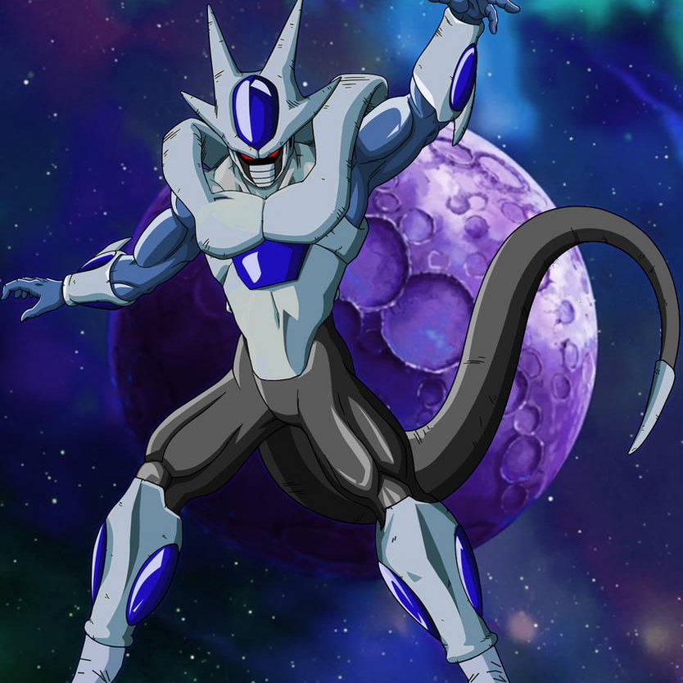

Findings
Balance
Takeaway
Overall, the feature importance is decently balanced, however, prediction strength relies most heavily on z (Infrared), possibly due to its ability to capture distant objects like Quasars
With high classification accuracy and decently balanced prediction strength of the feature (X) data, this model is well optimized
Accuracy
Classification accuracy is high, however, misclassification occurs most between Quasars and Galaxies due to their spectral similarities
Fun Fact
Star Wars was a documentary

Slide 26

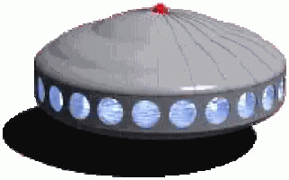
Hyperparameter Tuning Final Results:
Optimized Gradient Boosting Model Report:
precision recall f1-score support
star 0.92 0.96 0.94 832
galaxy 0.96 0.93 0.94 999
qso 0.90 0.89 0.90 169
accuracy 0.94 2000
macro avg 0.93 0.93 0.93 2000
weighted avg 0.94 0.94 0.94 2000

Slide 27



Findings
Fun Fact
Takeaway
1 tsp of a neutron star weighs the same as the human population
With parameter tuning, we were able to increase our model’s total predictive performance by over 6%
Accuracy
Our accuracy rates increased across all margins with hyperparameter tuning

Slide 28

Optimization with PCA
Advantages of Dimensionality Reduction:
Computational Efficiency
Model Performance
Overfitting Prevention
Better Visualization

Slide 29
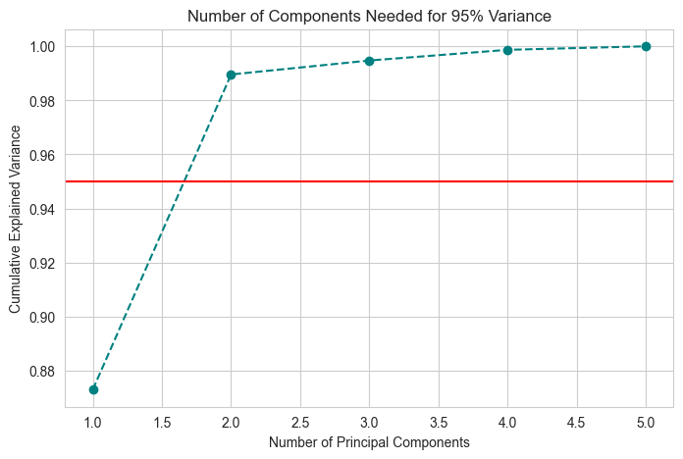
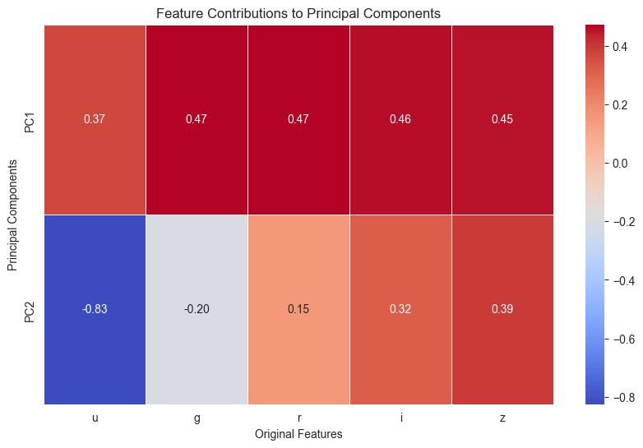
PCA Visual Aids

Slide 30

PCA
Results:
Gradient Boosting Model with PCA Classification Report:
precision recall f1-score support
star 0.71 0.70 0.71 832
galaxy 0.78 0.79 0.78 999
qso 0.81 0.82 0.81 169
accuracy 0.75 2000
macro avg 0.77 0.77 0.77 2000
weighted avg 0.75 0.75 0.75 2000

Slide 31
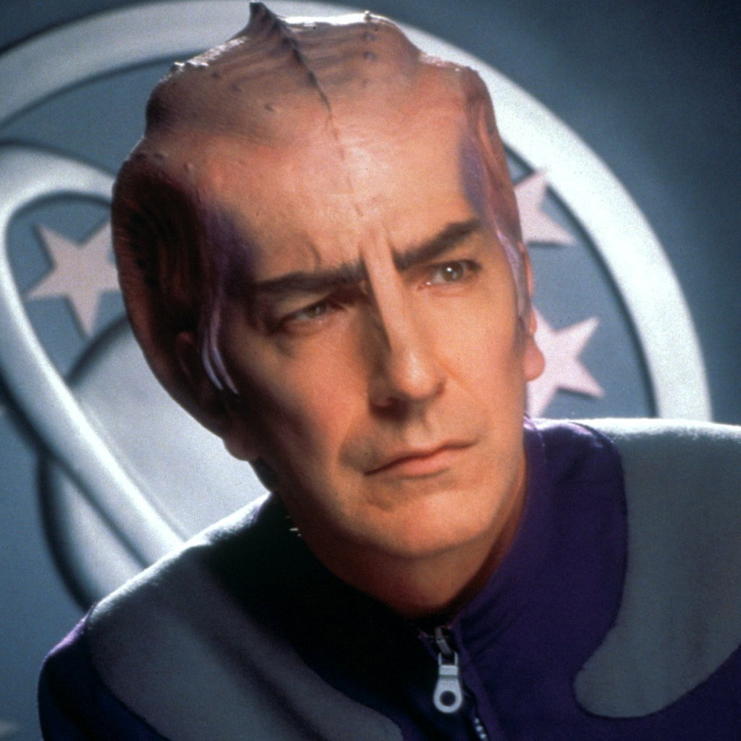
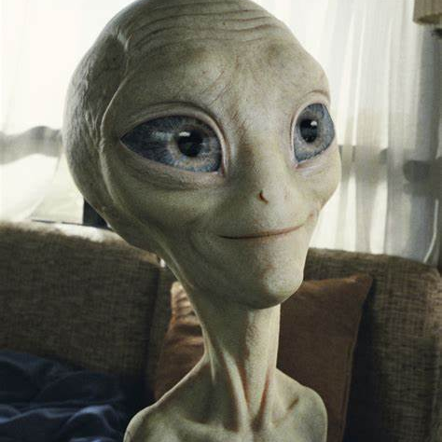
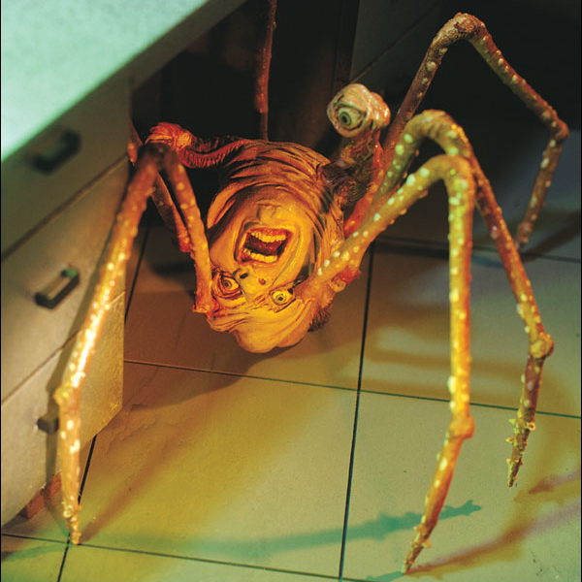
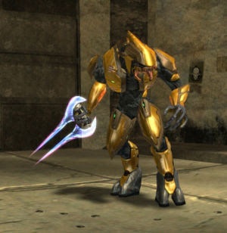
Findings
Accuracy
Takeaway
Despite high correlation, PCA data compression actually decreases our accuracy by nearly 20%
Using PCA for optimization is not a great fit for our dataset despite encouraging indications
Correlation
The projection plot shows that our data is highly correlated as only two principal components are needed to explain 95% of the data variance
Fun Fact
Uranus’ blue glow is due to the gases in its atmosphere

Slide 32
Conclusion
Using the Gradient Boosting Classifier we were able to train our machine learning model to distinguish between stars, galaxies, and quasars, achieving very high accuracy through systematic hyperparameter optimization.
Overall, our project pipeline integrates database extraction, model evaluation, and effective data visualization strategies. This work contributes to the automated classification of astronomical objects and demonstrates the broader application of machine learning in astrophysics.

Slide 33



Thank You!

Slide 34
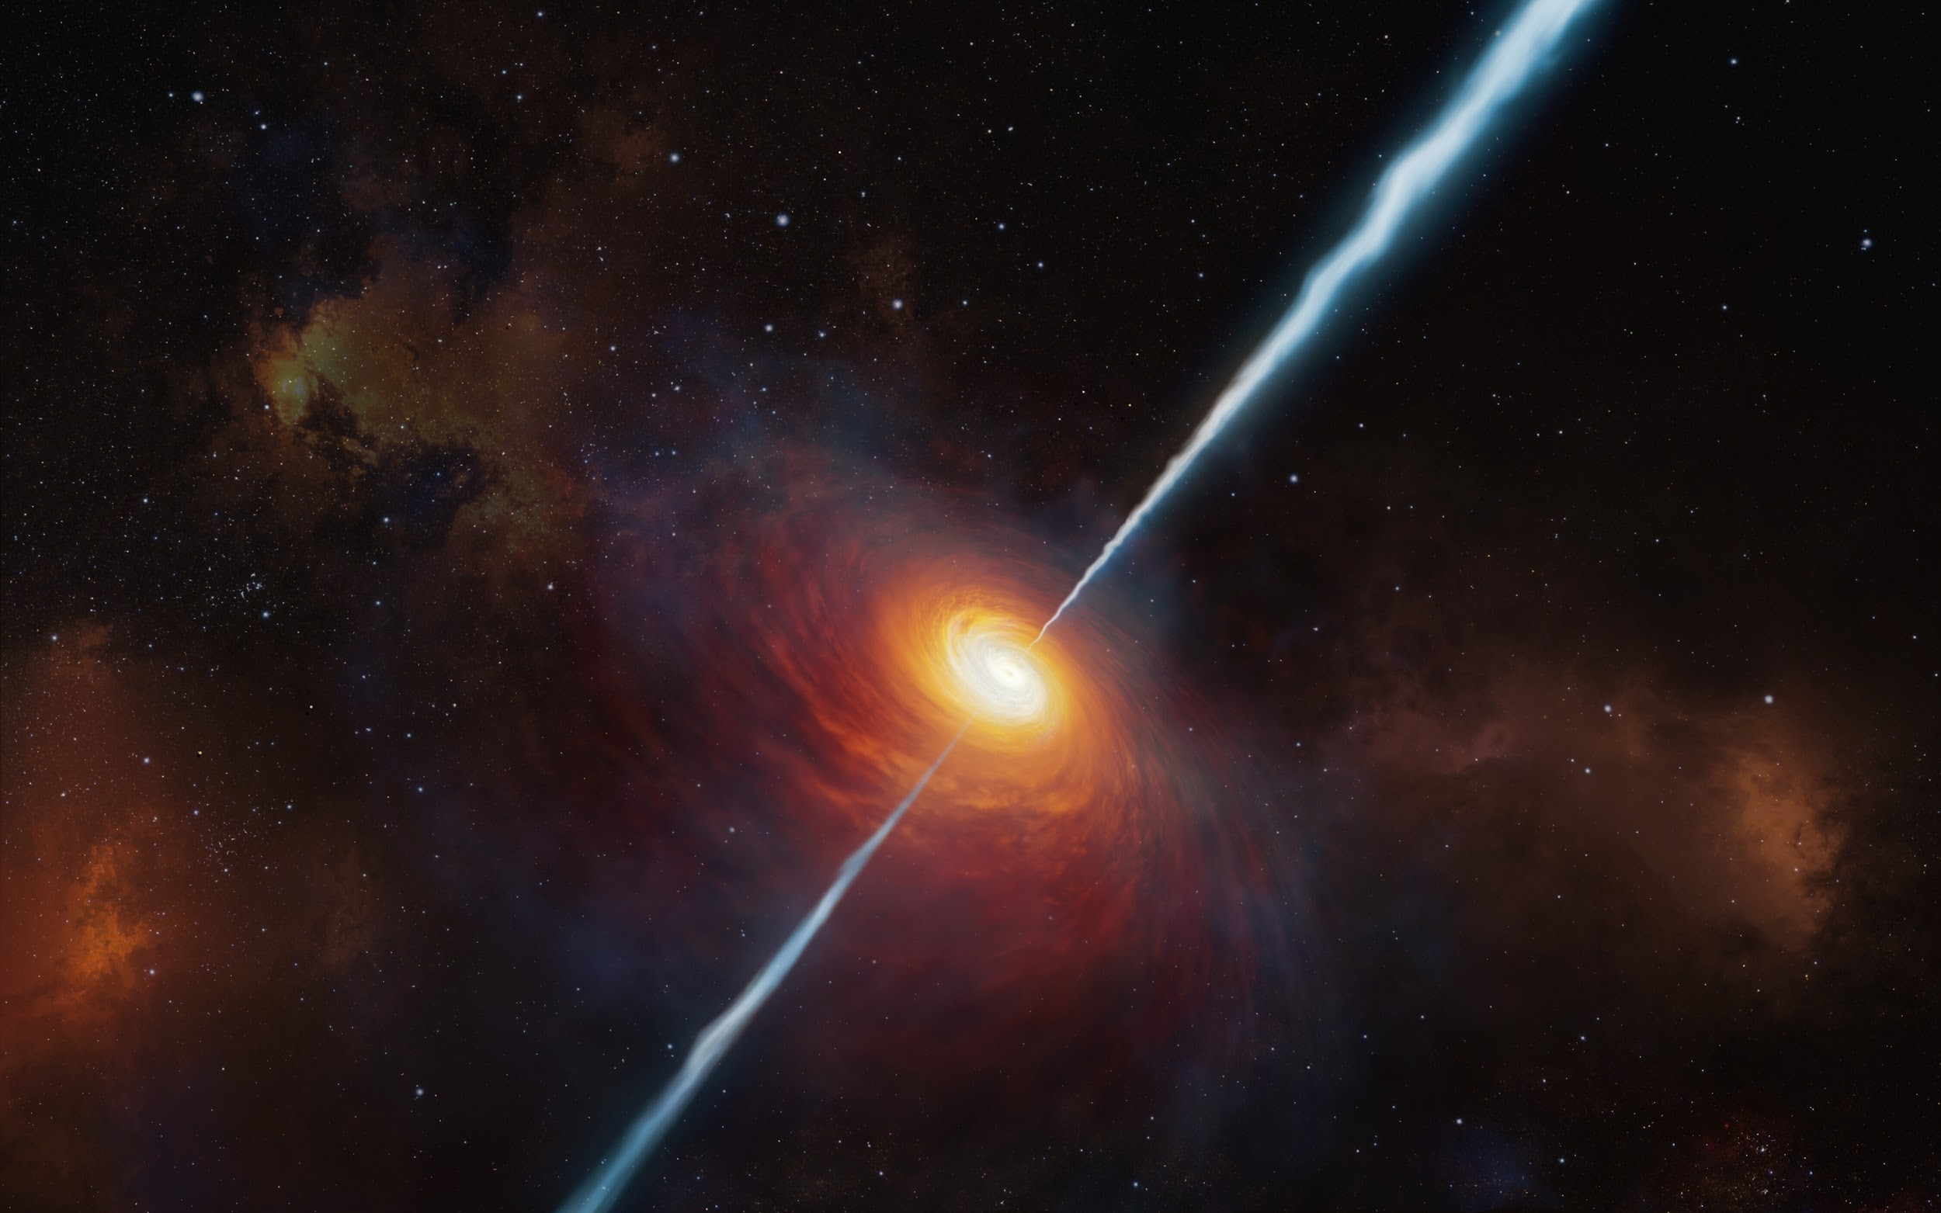
We are now opening the space gates for questions—fire away!

